Slide 1




The Power of Data-Driven Insights
In today's data-driven world, understanding and leveraging data is crucial for organizations to thrive. Data analysis provides valuable insights, enabling informed decision-making and driving innovation.
by Gayathri Harika

Slide 2

The Most Demanded Projects in the Current World
1
Artificial Intelligence (AI)
2
Cloud Computing
AI applications are transforming industries, from automation to personalized experiences.
Cloud platforms provide scalable and flexible computing resources, enabling businesses to innovate rapidly.
3
Cybersecurity
4
Data Analytics
As digital threats evolve, cybersecurity solutions are essential for protecting data and systems.
Data analysis empowers organizations to make informed decisions and gain a competitive edge.

Slide 3
Project 1: AI-Powered Customer Service
Benefits
Implementation
Impact
Improved customer satisfaction through faster response times, personalized interactions, and 24/7 availability.
Utilizing natural language processing (NLP) and machine learning (ML) to automate tasks and provide intelligent responses.
Enhanced customer experience, increased efficiency, and reduced operational costs.

Slide 4
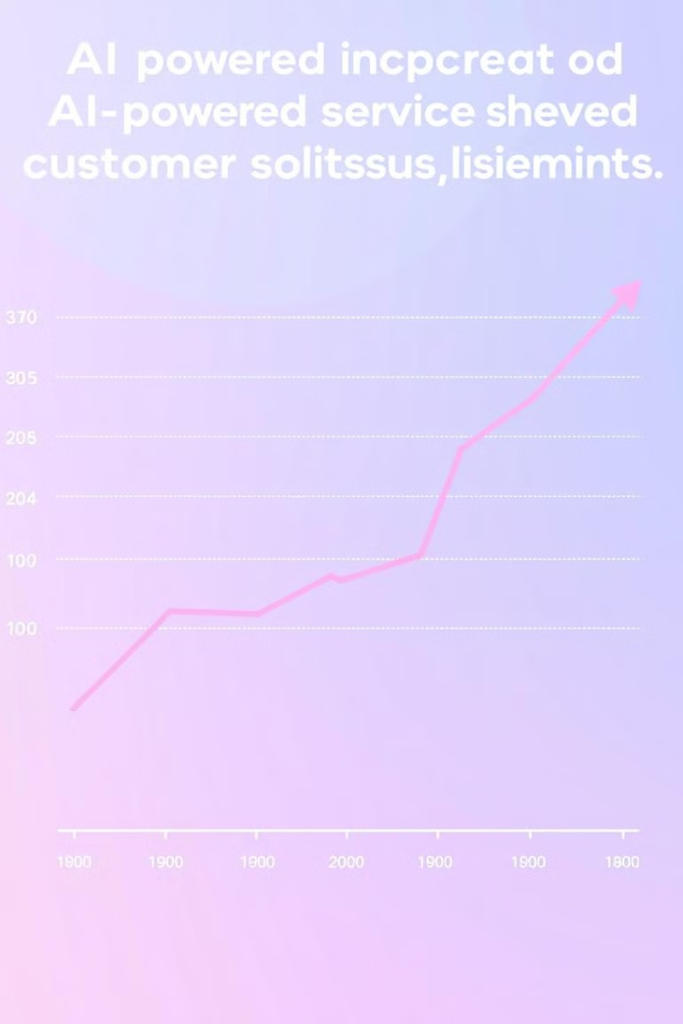
Key Insights and Trends
1
Increased Demand
Businesses are increasingly investing in AI-powered customer service solutions to enhance their customer experience.
2
Focus on Personalization
Customers expect personalized interactions, and AI enables tailored experiences based on individual preferences.
3
Integration with Other Systems
AI-powered customer service platforms are seamlessly integrating with existing CRM and communication systems.

Slide 5

Impact on the Future
Enhanced Customer Experience
Evolving Customer Expectations
AI-powered customer service will continue to improve, offering seamless and personalized interactions.
Customers will expect AI-powered solutions to be integrated into all aspects of their interactions with businesses.
Shift in Customer Service Roles
Customer service roles will evolve, focusing on higher-level tasks such as problem-solving and relationship building.

Slide 6

Project 2: Predictive Maintenance for Industrial Equipment
Benefit
Reduced downtime and maintenance costs.
Implementation
Utilizing IoT sensors to collect data on equipment performance and applying ML algorithms to predict potential failures.
Impact
Improved operational efficiency, increased equipment lifespan, and enhanced safety.

Slide 7
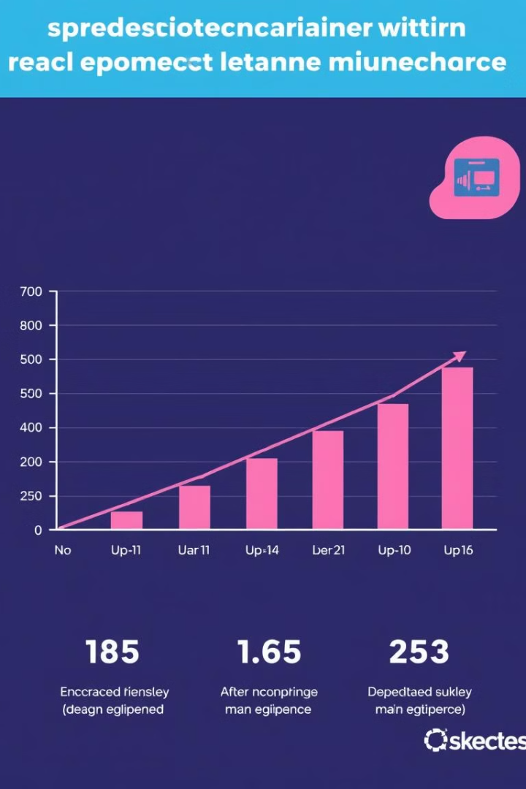



Key Insights and Trends
Data-Driven Insights
Predictive maintenance relies on analyzing vast amounts of data from sensors and equipment logs.
AI Algorithms
Machine learning algorithms are used to identify patterns and predict potential failures before they occur.
Real-Time Monitoring
Predictive maintenance systems enable real-time monitoring of equipment health, allowing for proactive interventions.

Slide 8

Conclusion: Leveraging Data to Drive Innovation
By embracing data-driven approaches, organizations can unlock new opportunities, improve efficiency, and drive innovation. These projects highlight the transformative power of data in shaping the future of industries.

